Slide 1

SESSION M 310
Be the mentor you wish you had

Slide 2


Session: M 301
Be the mentor you wish you had

Slide 3
“
A single conversation across the
table with a wise man is worth a
month’s study of books
”
-Chinese Proverb
CRUCIAL MENTORING CONVERSATIONS

Slide 4
What we will cover
Conversations that matter
How to guide and lead mentoring conversations
Intentional mentoring
Crucial mentoring conversations -
a-framework for deeper, insightful connects
5. Pouring yourself into others

Slide 5
“
A long time ago,
”
in a land far, far away…

Slide 6

The potential of Conversations
-Glasier

Slide 7
Reflection
Crucial Mentoring Moment
Your story?
A specific conversation that shaped your thinking
Advise / different perspective
Challenged your thinking
Greater hindsight, insight, foresight
Inspired you to action
Changed the course of your decisions

Slide 8
GUIDE & ASK - NON-DIRECTIVE
Ask instead of tell
Enhance aware- ness
Process
focus
COACHING
Leverage the fields otf coaching-mentoring
Knowledge focus
Influence and advise
Share experience
MENTORING
LEAD & TELL - DIRECTIVE

Slide 9
Qualities of modern mentors
Informed and experienced
Abundance
Accessible and available
Emotionally
intelligent
Honest and trusting
mentality -
genuine interest
Authentic
Multiplier
Listen and communicate
Objective and fair
Respected role model

Slide 10
Formal vs Informal mentoring
Is modern mentoring formal or informal
How great is the need in your business to formalise the mentoring process?
What do we lose by formalising mentoring?
What do we gain by keeping it informal?

Slide 11


Intentional mentors ensure
Functional
/Professional Competence
Territorial Wisdom
Purpose
/ Focus
Mindset
Institutional Alignment

Slide 12

What is a CMC?
“a discussion between a mentor and mentee that will assist both parties to break trough to new levels of understanding and insight on specific topics”
Authentic and reflective
Provides different views and and perspectives
Facilitates confidence to act

Slide 13
The purpose of a CMC for a Mentee
1 2 3 4
5
Gain
advantage
from- hindsight
-learning from mistakes
Allow greater
Opportunity
Ability to
Big picture
insight
to acquire
interpret and
thinking
- A deeper
foresight
respond in
- Actioning
understanding
- To be able
the present
specific
of cause and
to anticipate
moment
outcomes
effect

Slide 14

What are the essentials of a Crucial Mentoring Conversation?
Turn down the noise
Reciprocal contributions from both parties
Authentic trust
Actioning possible outcomes/assignments

Slide 15








CRUCIAL MENTORING CONVERSATIONS
PURPOSE
CAREER MOMENTUM
CLASSIFIED
NETWORKS
PERFORMANCE
RELATIONSHIPS
FITNESS
STRENGTHS

Slide 16
Reflect on your conversations
What is the focus of the conversation
What value does the conversation offer
Questions to guide
A relevant story or experience to lead
What are the possible outcomes or actions from the conversation?

Slide 17

PURPOSE

Slide 18

Vision is what you aspire to.
- “where am I
going?”
Purpose guides what you are doing with your life - “why do I exist?”
Mission drives you to achieve, - “what am I doing?”

Slide 19

PURPOSE
Why do I do what I do?
Individuals who pursue their purpose
Display focus
Have energy to pursue their dreams
Display mastery in what they do
Exhibit discipline – time and priorities
Show resoluteness – challenges
Demonstrate persistence/ endurance
CRUCIAL MENTORING CONVERSATIONS

Slide 20
PURPOSE
Vision – where and what do I see myself doing?
What do I aspire to?
Where am I going?
What excites me about my future?

Slide 21
PURPOSE
Values
Reflect on what values are the most important to you personally.
Think of a time that you were happiest, proud and most fulfilled.
Possibly a time when you made good choices.

Slide 22

CAREER MOMENTUM

Slide 23

Why this conversation?
The focus of this conversation is
Gain clarity on your mentee’s career
aspirations
Motivation around mobility.
It answers the basic question
Not about how to get promoted, but rather
“how employable is your mentee?”
What is required to be successful in a particular career and how to move his/her career forward?
CRUCIAL MENTORING CONVERSATIONS

Slide 24
CAREER MOMENTUM
Employability vs Marketability
Marketability, is the relative ease at which a commodity can be sold or marketed.
It is also an individual’s attractiveness to potential employers.
Employability, is determined by a set of achievements, an individual’s track record and personal attributes that make him more likely to be successful in a chosen career.
CRUCIAL MENTORING CONVERSATIONS

Slide 25
When is storytelling powerful?
When you have a story to tell about yourself
When you want to share a particular lesson
When you want to illustrate a moral or ethical issue
When you want to communicate across boundaries e.g. culture
When you want to share a truth
CRUCIAL MENTORING CONVERSATIONS

Slide 26
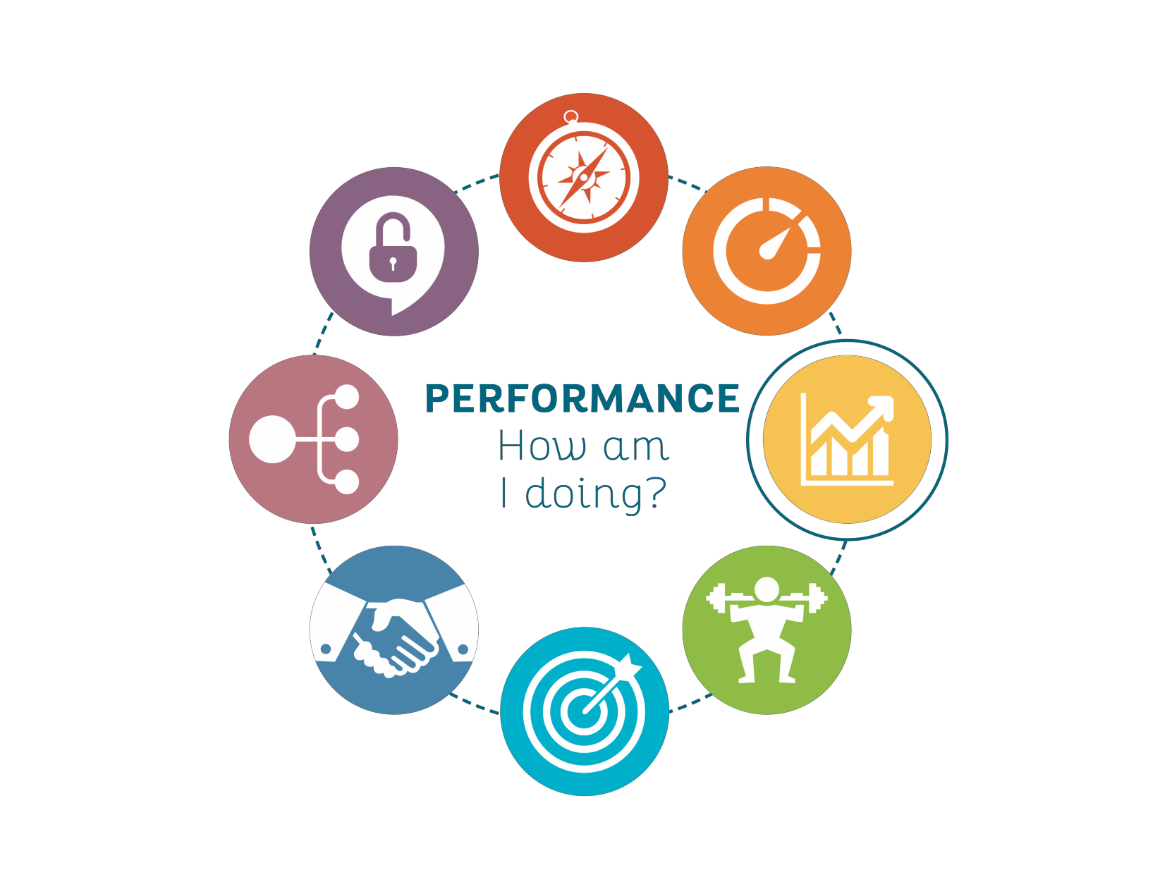
PERFORMANCE
CRUCIAL MENTORING CONVERSATIONS

Slide 27

Why this conversation?
The focus of this conversation is
To have a greater understanding of the current level of the performance and contribution
Focus is also on facilitating areas of both positive and helpful feedback.
It answers the basic question
How is my mentee doing / performing?
CRUCIAL MENTORING CONVERSATIONS

Slide 28

PERFORMANCE
Challenging your Performance Management paradigm
“The greatest contributor to high performance does not lie in the application of the formal aspects of the performance management system, but in the quality of relationships and trust.”
“More regular critical reflections and conversations will allow feedback to closely follow the natural cycle of work.”
CRUCIAL MENTORING CONVERSATIONS

Slide 29

FITNESS
CRUCIAL MENTORING CONVERSATIONS

Slide 30

Why this conversation?
The focus of this conversation is
Have a broader | understanding | of the
workplace skills opportunity | required for a | specific
A forward check to see how ready your mentee is and what he aspires to develop
It answers the basic question
How ready (adaptable and committed) is my mentee for the challenges and opportunities that are lying ahead?
CRUCIAL MENTORING CONVERSATIONS

Slide 31
FITNESS
Questions
If you were promoted tomorrow into the next level, role, job?
?
CRUCIAL MENTORING CONVERSATIONS

Slide 32

STRENGTHS
CRUCIAL MENTORING CONVERSATIONS

Slide 33

Why this conversation?
The focus of this conversation is
Assist mentors to recognise the talents of their mentees
Do my mentee’s strengths compliment the different roles?
Further explore the convergence of these talents and personal passions.
It answers the basic question
What is my mentee’s competitive advantage?
Is my mentee in the right territory?
CRUCIAL MENTORING CONVERSATIONS

Slide 34

STRENGTHS
2 flawless principles
Each mentees talents and strengths are enduring and unique
Each mentees greatest growth would be in the areas of his strengths

Slide 35
STRENGTHS
Focussing on strengths …
Is an accelerator
Your mentee will grow faster and develop
more in the areas of his strengths…
Is a multiplier
Your mentee will be more innovative and creative in the areas of his strengths…

Slide 36
STRENGTHS
Focussing on strengths …
Is a booster
Your mentee will be more inclined to bounce back from failure in the areas of his strengths
Is a confidence builder
Confidence comes from competence. Weaknesses erode confidence and self assurance

Slide 37

RELATIONSHIPS

Slide 38

Why this conversation?
The focus of this conversation is
Understand the importance of relationships
Look at ways to build relationships.
beneficial
It answers the basic question
How is my mentee perceived by others?
Is my mentee viewed differently than he
sees himself?
CRUCIAL MENTORING CONVERSATIONS

Slide 39

JOHARI WINDOW
Known to Self
Not Known to Self
Known
to Other
OPEN
BLIND
Not Known to Other
HIDDEN
UNKNOWN

Slide 40

NETWORKS

Slide 41

Why this conversation?
The focus of this conversation is
Explore the diverse relationships that your mentee should manage and leverage.
It answers the basic question
With whom should/could my mentee network and build alliances?

Slide 42
NETWORKS
Questions
How will you conversation?
guide
and lead
this

Slide 43

CLASSIFIED

Slide 44

Why this conversation?
The focus of this conversation is
Create a platform and a safe place to talk about specific realities, opportunities and challenges
It answers the basic question
Are there any matters that my mentee would like to discuss off the record?

Slide 45
SELF CONCEPT
Understand self, our purpose and what we value most in life.
Hopes and dreams.
SELF REGULATION
Understanding choices, Behaviours and actions.
SELF IDENTITY
Recognising how We connect and relate to others.
SELF DEVELOPMENT
Gradual process of developing character, Strengths, abilities and skills.

Slide 46
Pouring yourself into someone

Slide 47
Evaluating impact
What have we accomplished?
Have we met the initial objectives?
Can we apply lessons and knowledge gained?
What core skills were acquired?

Slide 48
THANK YOU
Peoplesdd@mweb.co.za

