Slide 1
Talent Development in a VUCA World
Bob Grassberger and Bill Meador

Slide 2
Question # 1.
What is VUCA?
What does a VUCA world look like?
Notes:
Consider what VUCA means to talent. How might a volatile, uncertain, complex, and ambiguous world influence them?
How would you prepare for work in a VUCA world? What would be your strategy?

Slide 3
VUCA
Volatility
Uncertainty
Complexity
Ambiguity
An acronym originated by a US Army Military College to indicate new challenges faced by leaders
Increasing rate of change
Less clarity about the future
Multiple decision factors
There may be no “right” answer
Notes:
1. Volatility – the rate, amount, and magnitude of change. 2. Uncertainty – the amount of unpredictability inherent in issues and events. 3. Complexity – the amount of dependency and interactive effect of multiple factors and drivers. 4. Ambiguity – the degree to which information, situations, and events can be interpreted in multiple ways.

Slide 5
Notes:
Have you ever had a volatile boss? What does that do to you emotionally?

Slide 6
Notes:
Have you ever gotten that call “we need to meet” but with no indication of what it’s about?

Slide 7
Notes:
You ever gone into a meeting where you were sure you were an expert and, in the midst of the meeting realized that you have no idea what they are talking about?

Slide 8
Notes:
Have you ever realized that you live in a bubble comprised of people who all see the world in the same way you do? Church, political campaign, other countries. Importance of a diversified network.

Slide 9
Question # 2.
How does VUCA impact existing workers or entering the workforce?
Career planning / long-term employment?
Work Readiness e.g., Education / Experience?
Emotionally?
Notes:
Consider what VUCA means to talent. How might a volatile, uncertain, complex, and ambiguous world influence them?
How would you prepare for work in a VUCA world? What would be your strategy?

Slide 10
VUCA Angst
“Today’s workers have to prepare like someone who is training for the Olympics but doesn’t know what sport they are going to enter.”
Gene Sperling
Economic advisor to Clinton & Obama
Notes:
Synopsis statement
Three questions about your career – ROUTINE work?
Can someone overseas do it cheaper?
Can a computer do it faster?
Is what you are selling in demand in an age of abundance? Does what you are selling have significance or just utility?

Slide 12
Question # 3.
How does VUCA impact employers?
Competitive Advantage / Global Competition?
Filling the Pipeline? (Talent as a strategic asset)
Investments in Talent?
Notes:
Consider what VUCA means to employers. How might a volatile, uncertain, complex, and ambiguous world influence them?
Given that the right talent offers “competitive advantage” how do you plan for the success of your firm?

Slide 13
Outsourcing to Machines
Cognitive
Creative jobs
Routine
Creative
First Machine Age
Anchored jobs
Manual
Notes:
Alternative to outsourcing – automation (labor vs capital)

Slide 14
Second Machine Age Brynjolfsson & McAfee
Jobs are being lost to automation & outsourcing
Cognitive
Creative jobs
Second Machine Age
Routine
Creative
Anchored jobs
Manual

Slide 15
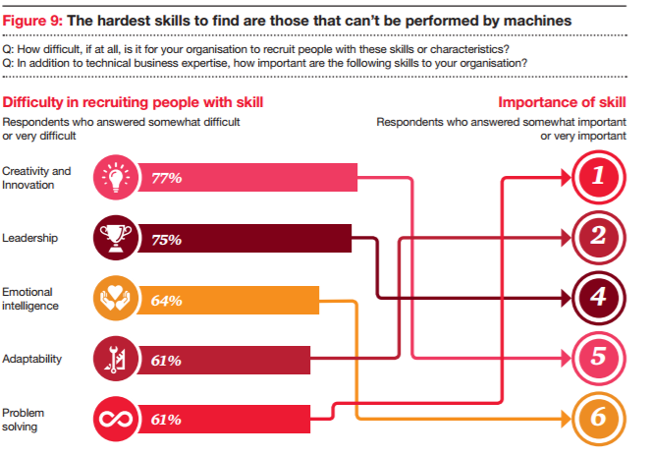
“20th Annual CEO Survey.” PWC, January 2017

Slide 16
5 Things to Tell Your Workforce / Kids
Robots (probably) aren’t taking over
You’ll be in school the rest of your lives
You can be your own boss
Focus on social skills
The future is up to you
5 things I’m telling my kids to prepare them for the future

Slide 17
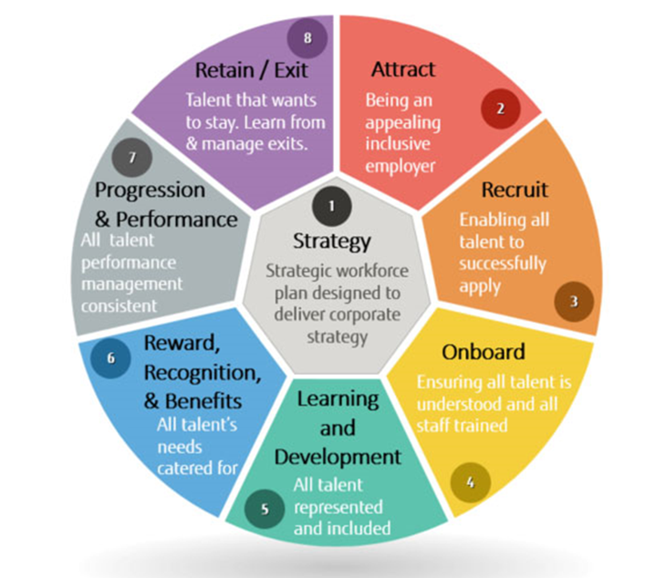
A Typical Talent Cycle Model
Notes:
A typical talent development cycle. Note that not all components are under the control (owned by) of L&D. When talent is important to an org (sees it as strategic) we see L&D in the C-suite (seat at the table).

Slide 18
Question # 4.
How does VUCA impact talent developers?
Attracting Talent?
Keeping Talent?
Developing Capabilities / Growing Talent?
Notes:
Consider what VUCA means to employers. How might a volatile, uncertain, complex, and ambiguous world influence them?
Given that the right talent offers “competitive advantage” how do you plan for the success of your firm?
An April 2018 study by Catalant found that 63 percent of surveyed companies had a FoW plan in place. The bad news? By the time the proverbial ink is dry, those plans may be out of date or misaligned to the changing dynamics of the FoW

Slide 19
Strategic Roles of Learning & Talent Development
Learning & Talent Development
Develop People Capabilities
Attract & Retain Talent
Motivate & Engage Employees
Build Employer Brand
Create a Values-Based Culture
Adapted from van Dam, N. (2008). 25 Best Practices in Learning and Development, 2nd Edition

Slide 20
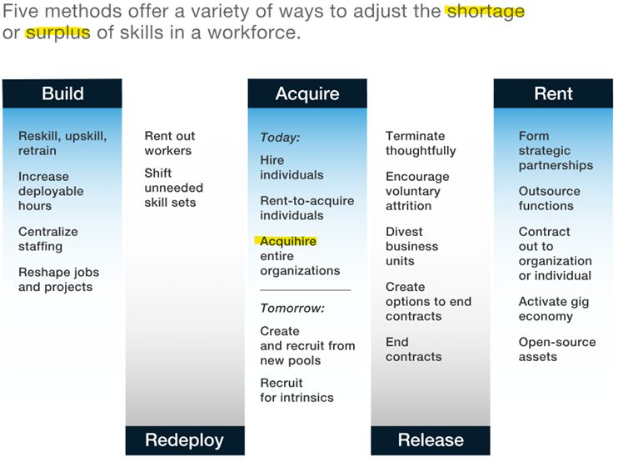

Slide 21
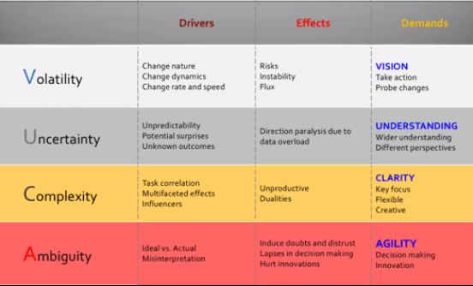
Remedies for VUCA

Slide 22
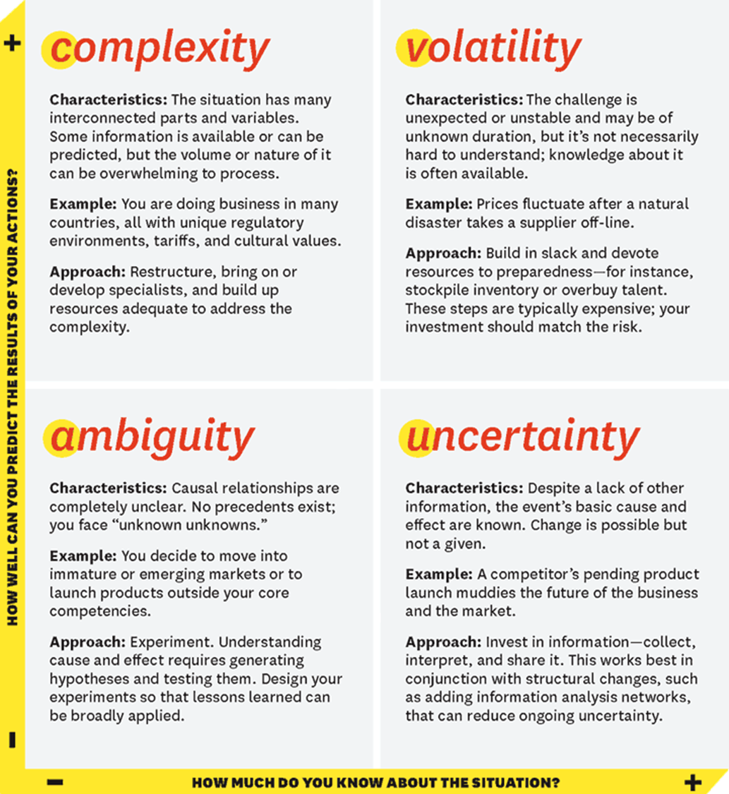

Slide 23
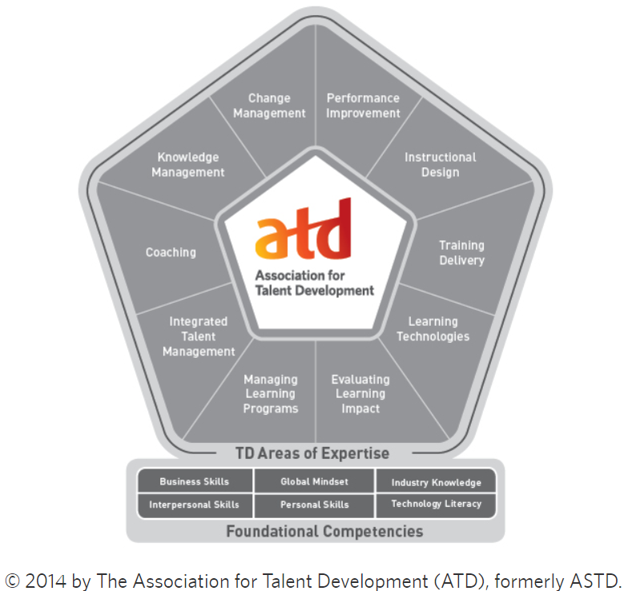

Slide 24
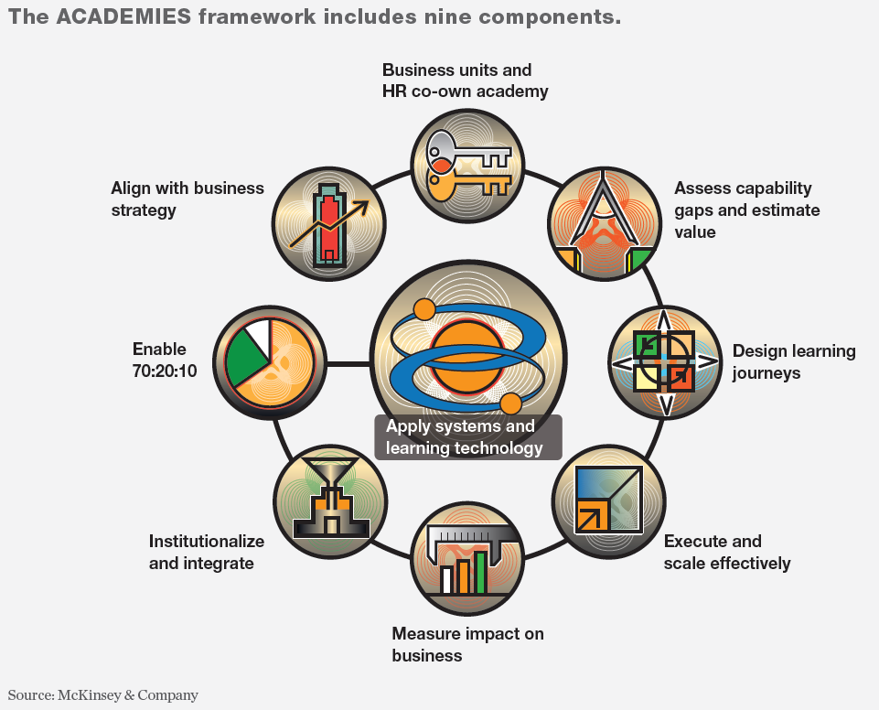
Notes:
OSF ratio (On the job, Social, Formal) instead of 70-20-10.

Slide 25
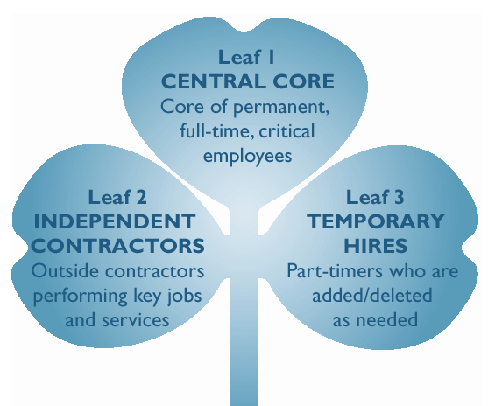
The Shape of Things Shamrock Organization*
Core
Consultant
Contingent
* Handy, C. (1988)
Notes:
How do we handle labor costs == Outsourcing vs offshoring ➔ shift to projects / gigs

Slide 26
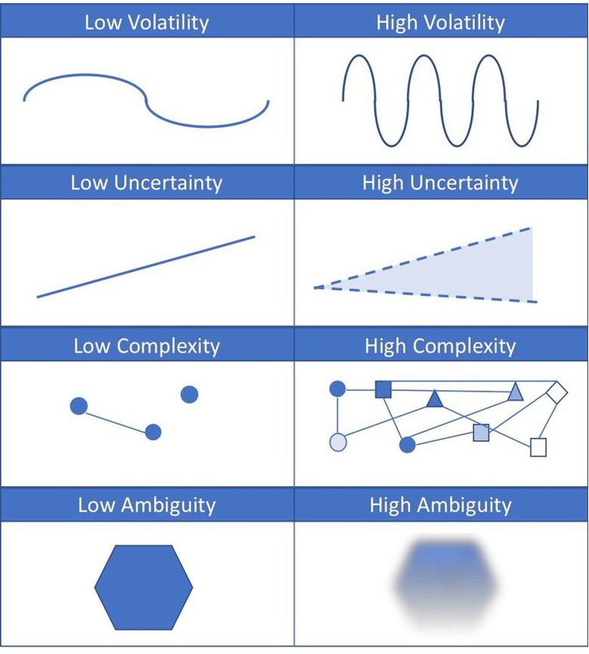

Slide 27
Institute for the Future - IFTF.org

Slide 28
Shaping Work of the Future -
FREE / MOOC*
( * Massive Open Online Course )
Explore ways to improve job opportunities
and develop a personal plan for lifelong career success.
Started on March 19
You can still enroll / register
Shaping Work of the Future

Slide 29
Next month at ATD - NM
Thur 18 April - 5:30pm @ Bohannan Huston
The Future of Talent Development
Panel Discussion
Jessica Nojek – Mission: Graduate
Russ Romans, Ed.D. – University of New Mexico

Slide 30
Close It.org
October 15 – 16

Slide 31
Talent Development in a VUCA World
Bob Grassberger and Bill Meador

